Slide 1
Introduction to Databases
Key Concepts:
Data vs Information vs Knowledge
Databases vs DBMS
Types of Databases
Single/Multiple user, Centralized/Distributed, Transactional/Analytical
Why databases – why not store data in files?
Relational Databases
Developed by Ted Codd and others during 1970s
NoSQL (“not only SQL”)
Gaining popularity during 2010s

Slide 2
Importance of Data
"Data is so widely available and so strategically important that the scarce thing is the knowledge to extract wisdom from it. That is why statisticians and database managers and machine learning people are really going to be in a fantastic position." – Hal Varian, Google's chief economist, 2009.
"Information will be the 'oil of the 21st century'. It will be the resource running our economy in ways not possible in the past.” – Peter Sondegaard, Gartner, 2010.
"Data is to the information society what fuel was to the industrial economy: the critical resource powering the innovations that people rely on." - Viktor Mayer-Schonberger & Kenneth Cukier, "Big Data", 2013.

Slide 3
Importance of Data
"the most upwardly mobile people in society right now are those who can manipulate code to create algorithms that can sprint through oceans of data, recognize millions of faces, and perform tasks that just a few years ago seemed unthinkable." - Christopher Steiner, "Automate This".
"Unlike almost every other commodity, information becomes more valuable the more it is used." – Timothy Wu.
"You need the database as much as the database needs you." – Helen Philips, "The Beautiful Bureaucrat".

Slide 4
Data, Information & Knowledge
Data are the raw, individual, facts.
E.g. Pat Smith bought coffee at Uncommon Grounds on 2013/08/14 at 2:30pm for $2.50.
Information is a general fact, usually the result of aggregated data.
E.g. Uncommon Grounds sells most of its coffee in the afternoon.
E.g. Customers spend less on coffee on Mondays than other days.
Knowledge is meaningful, useful, verified, information.
E.g. Sales of coffee are falling because of rising prices.
Information is produced by processing and analyzing data.
Knowledge reveals the meaning of the information.
Accurate, relevant, timely knowledge is the key to good decision making.

Slide 5
What is a Database?
A database is a computer structure (hardware and software) that stores data consisting of:
End-user data: raw facts of interest to end-user.
Metadata: data about end-user data
Provides description of data characteristics (e.g. data- types, allowed values) and relationships in data.
Complements and expands value of data.

Slide 6
What is a DBMS?
Data management studies how to generate, store, process and retrieve data.
A database management system (DBMS) is software that:
Manages the structure of the database.
Controls access to the database.
Acts as an intermediary between the users (people or applications) and the database.
Hides the details of how the underlying data is stored.

Slide 7
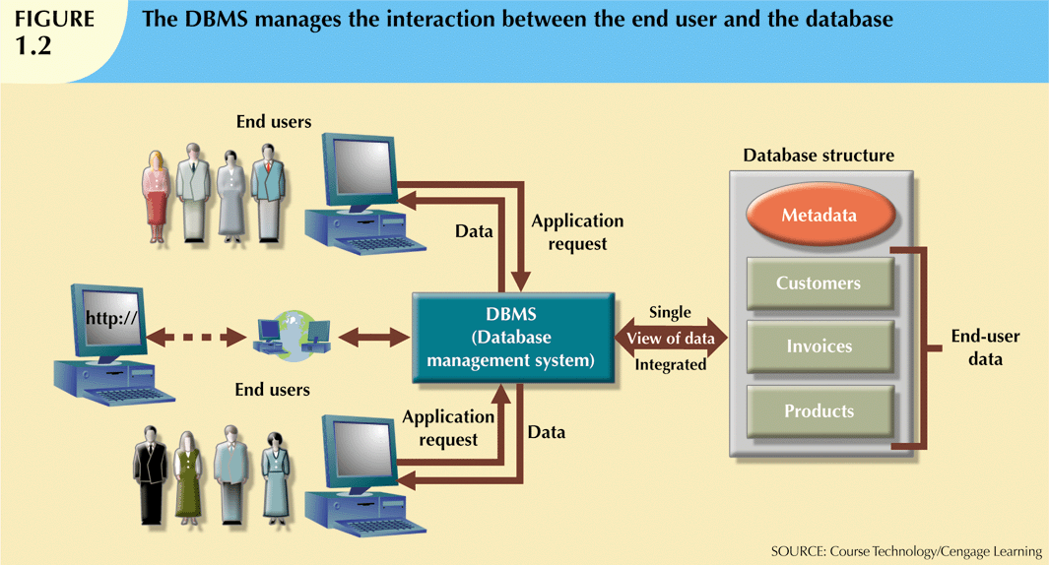
DBMS & Database

Slide 8
Types of Database
Databases can be classified along many dimensions.
Number of users:
Single-user database supports only one user at a time.
Desktop database: single-user database that runs on a personal computer.
Multiuser database supports multiple users at the same time
Workgroup database supports small (< 50) number of users.
Enterprise database supports large number of users.
Location:
Centralized database: data located at a single site.
Distributed database: data distributed across several different sites.

Slide 9
Types of Database (ctd)
Purpose:
Operational database: supports a company’s day-to-day operations.
Also known as transactional or production or online transactional processing (OLTP) database.
Analytical database: stores data used for long-term tactical or strategic decisions.
Online analytical processing (OLAP) provides tools for analyzing data in an analytical database.
A data warehouse is an analytical database that serves an entire organization.
A data mart is an analytical database that serves part of an organization.

Slide 10
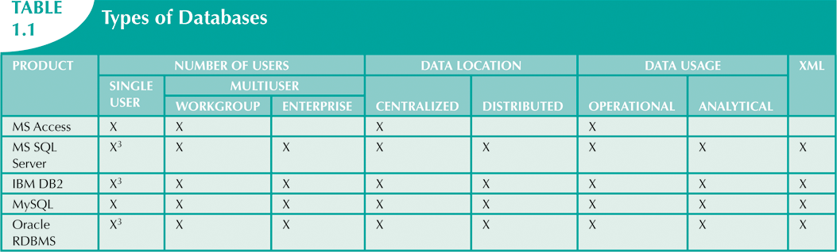
Some Major DBMS
X³ means the vendor sells a single-user version.

Slide 11
SQL Server
In this class we will use Microsoft SQL Server, also called MS SQL Server or just SQL Server.
To install SQL Server on your own computer, you can either:
Download a free version, SQL Server Express, from https://www.microsoft.com/en-us/server-cloud/products/sql-server-editions/sql-server-express.aspx
Obtain for free the Developer version (the one installed in the labs). Contact me if you want to do this. Installation instructions are at http://social.technet.microsoft.com/wiki/contents/articles/23878.installing-sql-server-2014-step-by-step-tutorial.aspx

Slide 12
Why not store data in files?
Files have many formats, so programs to access data need to be custom-written.
Difficulty in creating reports as user needs change.
Difficult to enforce data integrity – making sure the data is valid.
If the same data occurs multiple times (data redundancy), inconsistencies can easily arise.
Changing the existing data structure is difficult.
No standard security features or automatic backup.
Hard to administer large number of files.
Hard to handle huge amounts of data (because the entire file cannot be read into memory).
Note: Similar problems occur with widely-used tools like Excel; spreadsheets are not databases and are not appropriate for many tasks.

Slide 13
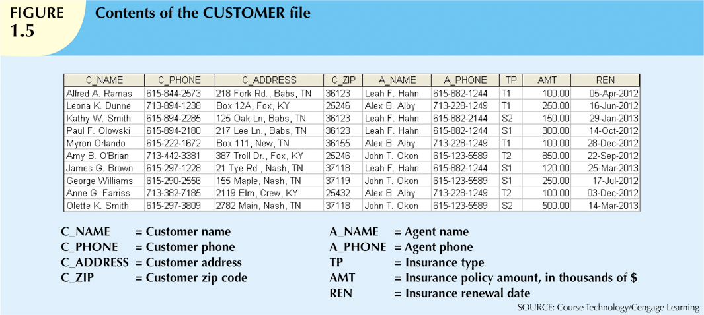
Why not store data in files - Example
How easy is it to determine which agent has sold the most?
Data redundancy – if an agent's phone number changes, it must be changed
in multiple places.
Some of the data is invalid!

Slide 14
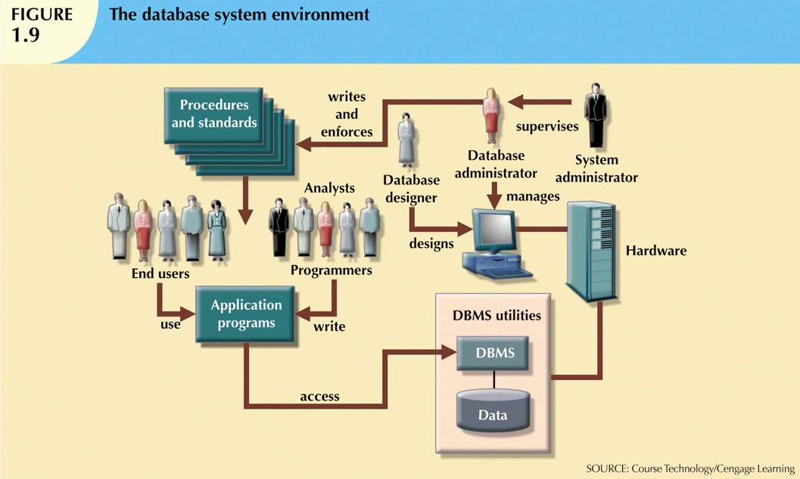
Database System Enviroment

Slide 15
Database System Enviroment
Hardware: all the system’s physical devices.
Software:
Operating system software.
DBMS software.
Application programs and utility software.
People: all users of the database system.
System and database administrators.
Database designers.
System analysts and programmers.
End users.
Procedures: Policies and rules that govern the design and use of the database system.
Data: the collection of facts stored in the database.

Slide 16
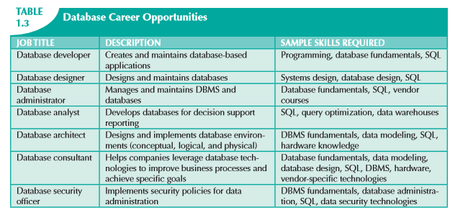
Database Career Opportunities

Slide 17
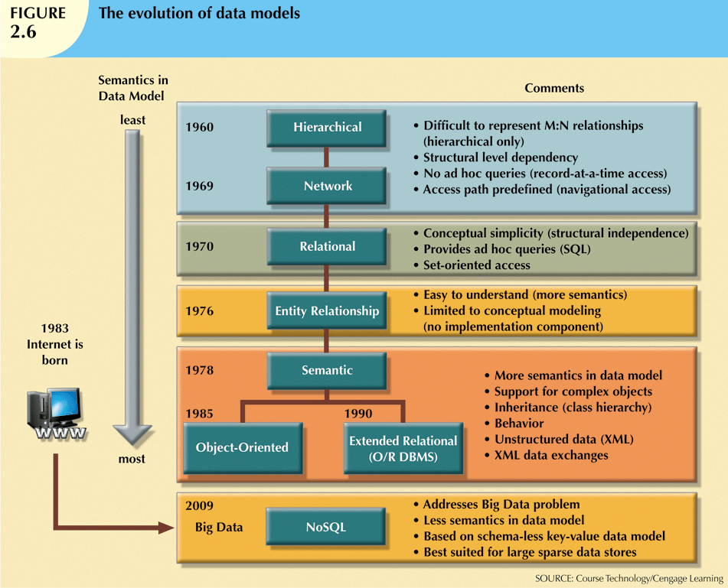
History of DBMS Technology
Internet
Protocol
standardized
In 1983;
The network
itself dates
from 1969.

Slide 18

The Relational Model
The relational model was developed in 1970 by Edgar Frank "Ted" Codd (1923 - 2003) while at IBM.
Data is stored in tables (relations).
Each row in a relation is an instance.
Each column in a table is an attribute.
Relationships between tables are maintained using
primary and foreign keys.
Relational models were considered impractical in 1970.
Model was conceptually simple at expense of computer overhead.
The first attempt to implement it was by Don Chamberlin and others at IBM in the mid 1970s.
System R, never released, but led to the development of what became SQL.
Oracle was the first company to release relational database software, in 1979.
Version 2.0; Version 1.0 never existed.
Relational models became the dominant database technology from the 1980s till today.

Slide 19
NoSQL
Since the 1980s various alternatives to the relational model have developed (e.g. object-oriented databases), but none have become popular until recently.
Recently (since ~ 2010), NoSQL databases have emerged as an alternative to the relational model.
Motivated by the need to analyze "big data".
Support distributed database architectures.
Provide high scalability, high availability, and fault tolerance.
Led by Google (Hadoop) and Amazon (Dynamo).

